Slide 1
BT 601: Analytical Biotechnology
-Prof. Siddhartha Sankar Ghosh
Lec-5

Slide 2

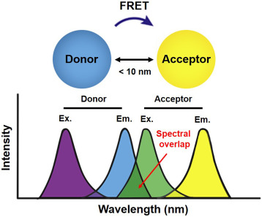

Slide 3
Applications of Fluorescence Spectroscopy

Slide 4
A nanomotor is a molecular or nanoscale device capable of converting energy into movement. Biological motor: Kinesin uses protein domain dynamics on nanoscales to walk along a microtubule.

Slide 5
A ribosome is a biological machine that utilizes protein dynamics on nanoscales

Slide 6
DNA Nanomotor

Slide 7
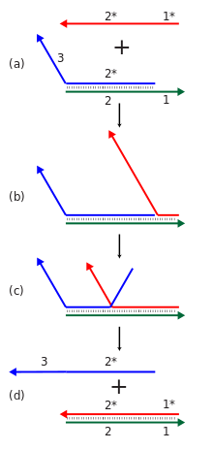
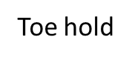
DNA nanomotor is based on Strand displacement cascades. Cascades of strand displacement reactions can be used for either structural or computational purposes.
Toe hold
Thermodynamically stable

Slide 8
A DNA-fueled molecular machine made of DNA
Molecular recognition between complementary strands of DNA allows construction on a nanometer length scale.
A DNA machine is reported here in which the DNA is used not only as a structural material, but also as `fuel'.
The machine, made from three strands of DNA, has the form of a pair of tweezers.
It may be closed and opened by addition of auxiliary strands of `fuel' DNA; each cycle produces a duplex DNA waste product.

Slide 9
Operation Principle:
TET: Carboxy-2,4,7,7-tetrachlorofluorescein
TAMARA: Carboxytetramethylrhodamine

Slide 10
Different Oligonucleotides for operation

Slide 11
Operation Principle:

Slide 12
Cycle of Operation:

Slide 13
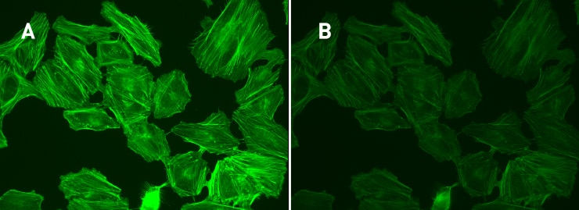
Photobleaching
In optics, photobleaching (sometimes termed fading) is the photochemical alteration of a dye or a fluorophore molecule such that it permanently is unable to fluoresce.

Slide 14
Molecular Biology-based evidence

Slide 15
THANK YOU

